Slide 1


Enhancing Search Engine Relevance for Video Subtitles
KIRANKUMAR PAMARTHI
IN1240999

Slide 2
AGENDA
Introduction
Data Ingestion and Understanding
Data Cleaning for Subtitle Documents
Text Vectorization Techniques
Document Chunking for Embedding
ChromaDB Database for Storing Embeddings
Document Retrieval Process
Performance Enhancement and Considerations

Slide 3

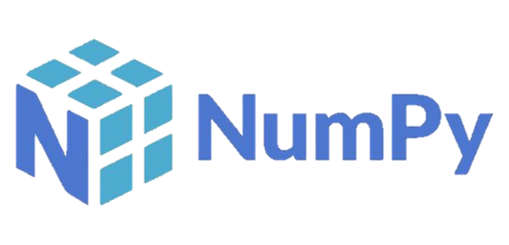
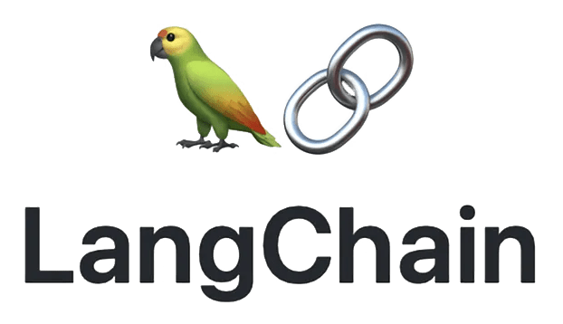



Introduction
Objective:
Develop an advanced search engine algorithm that efficiently retrieves subtitles based on user queries, specifically emphasising subtitle content. The primary goal is to leverage natural language processing and machine learning techniques to enhance the relevance and accuracy of search results.
Libraries used:

Slide 4
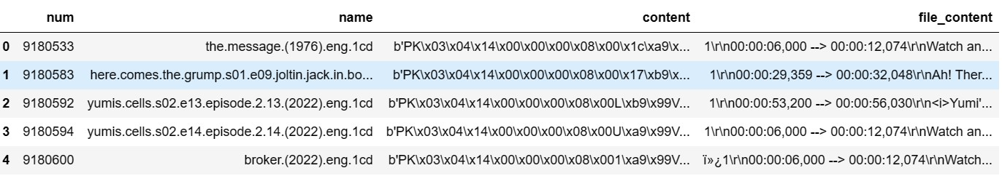
Data Ingestion and Understanding
Introduction:
Begin with an overview of the data source, which is a database file named eng_subtitles_database.db.
Mention that the database contains 82,498 subtitle files from opensubtitles.org, primarily focusing on movies and TV series released between 1990 and 2024.
Highlight the importance of data ingestion for processing and analyzing subtitle data.
Database Structure:
Explain that the database file is structured with a table named ‘zip files', consisting of three columns: num, name, and content.
num: Unique Subtitle ID reference for opensubtitles.org.
name: Subtitle File Name.
content: Compressed subtitle files stored as binary data using ‘Latin-1' encoding.
Data Retrieval:
Describe the method of data retrieval using SQLite3, a popular database management tool.
Emphasize the SQL queries used to extract relevant information from the 'zipfiles' table, such as retrieving subtitle names and Unique Subtitle IDs.
Content Decoding:
Explain the process of decoding the compressed subtitle files stored in the 'content' column using ‘Latin-1' encoding.
Highlight the importance of decoding for accessing and understanding the textual content of subtitle files.
Linking to Opensubtitles.org:
Introduce the concept of linking Unique Subtitle IDs to opensubtitles.org for accessing detailed information about each subtitle.
Provide the format of the link: https://www.opensubtitles.org/en/subtitles/{num}, where {num} is the Unique Subtitle ID.

Slide 5
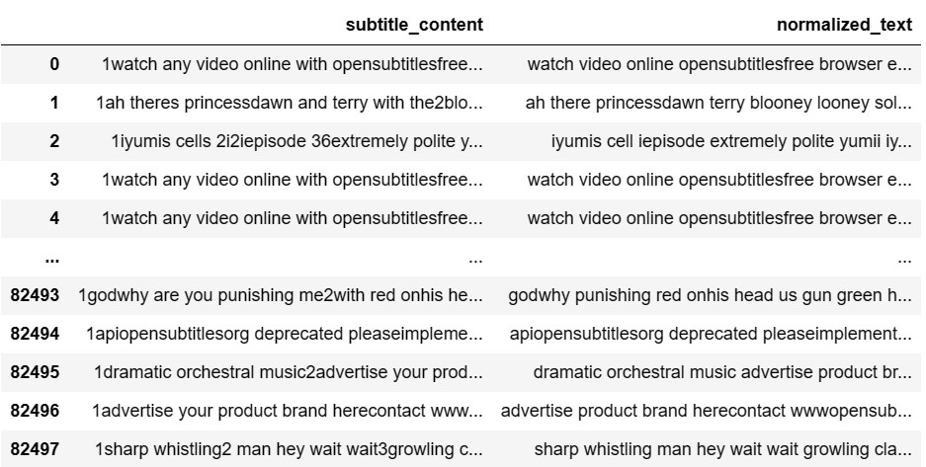
Data Cleaning for Subtitle Documents
Introduction:
Start with the importance of data cleaning in preparing subtitle documents for analysis and processing.
Mention that data cleaning involves removing irrelevant information, special characters, and noise from the text data.
Cleaning Techniques Used:
Removing Timestamps: Utilize regular expressions to remove timestamp patterns like "00:00:00,000 --> 00:00:00,000" from the subtitle text.
Removing Non-Printable Characters and Special Characters: Implement regex to eliminate non-printable characters and special symbols from the text.
Removing HTML Tags and URLs: Use regex to strip HTML tags and URLs from the subtitle text.
Removing Line Breaks and Extra Spaces: Apply regex to get rid of line breaks, multiple spaces, and extra whitespaces in the text.
Converting to Lowercase: Convert the cleaned text to lowercase to ensure consistency in text representation.
Removing Irrelevant Content: Utilize regex to eliminate short words with one or two characters, which are often irrelevant.
Nomalised Preprocessing Steps:
Removing digits, special characters, and punctuation using regex.
Tokenizing the text into words.
Removing stopwords (commonly used words) and non-alphabetic words.
Lemmatizing the text to reduce words to their base form.

Slide 6
Text Vectorization Techniques
Keyword-Based Search:
Relies on matching specific keywords or phrases in the search query with corresponding words or phrases in the text.
Limited by exact keyword matches and may miss contextually similar or related content.
Suitable for simple keyword searches but lacks semantic understanding.
Semantic Search:
Focuses on understanding the meaning, context, and relationships between words and phrases in the text.
Utilizes advanced natural language processing (NLP) techniques to capture semantic similarity and relevance.
Enables more accurate and context-aware search results, even for queries with varied wording or synonyms.
Vectorization Techniques:
Bag-of-Words (BOW):
Represents text as a collection of unique words (bag) without considering grammar or word order.
Each word is assigned a numerical value based on its frequency in the document or corpus.
Simple and effective for keyword-based search but lacks semantic understanding.
Term Frequency-Inverse Document Frequency (TF-IDF):
Considers both term frequency (TF) and inverse document frequency (IDF) to weigh the importance of words.
TF measures the frequency of a term in a document, while IDF penalizes common terms across documents.
Highlights words that are frequent in a document but rare across the corpus, capturing their uniqueness.
BERT-Based SentenceTransformers (Semantic Search):
Utilizes Bidirectional Encoder Representations from Transformers (BERT) for contextualized word embeddings.
Captures semantic relationships and context within sentences or documents, enabling semantic search.
Provides rich, high-dimensional embeddings that encode semantic information for accurate similarity assessment.
Benefits and Applications:
Keyword-Based Techniques (BOW, TF-IDF): Suitable for building basic keyword search engines.
Effective for information retrieval tasks where exact keyword matches are sufficient.
Limited in capturing semantic nuances and context.
Semantic Search (BERT-Based): Enables advanced semantic search engines with context-aware understanding.
Ideal for applications requiring accurate retrieval of contextually similar or related content.
Enhances user experience by providing more relevant and meaningful search results.

Slide 7
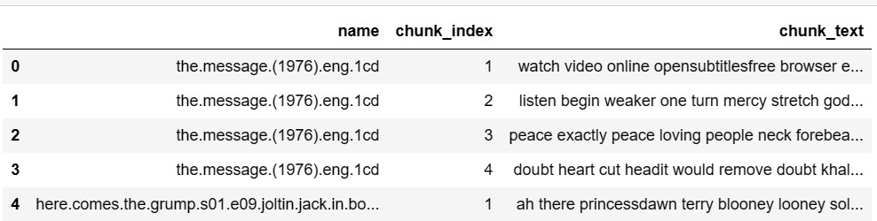
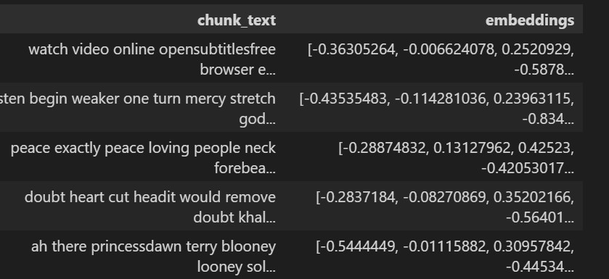
Document Chunking for Embedding
Document Chunking Process:
The purpose of the document_chunker function is to split documents into chunks based on token count.
Specify the parameters such as chunk_size (default 1500 tokens) and overlap_size (default 200 tokens) for chunk creation.
Highlight that each chunk contains metadata like the subtitle name, chunk index, and chunk text.
Utilize the document_chunker function to iterate over each document in the dataset and create chunks.
Store the generated chunks in a structured format for further processing and embedding.
Embeddings Used:
Introduce SentenceTransformers, a library for generating sentence embeddings using pre-trained models.
Specify the model used, such as "distilbert-base-nli-mean-tokens," which is based on DistilBERT and averages token embeddings for sentence representation.
Explain the benefits of using DistilBERT-based models, including lower computational requirements (dimensionality) and faster inference speed compared to larger models like BERT.
Benefits of Document Chunking for Embedding:
Summarize the benefits of document chunking for embedding, including:
Efficient handling of large documents by breaking them into manageable segments.
Mitigation of information loss and context fragmentation through overlapping chunks.
Improved performance and resource utilization during embedding generation.

Slide 8
ChromaDB Database for Storing Embeddings
Introduction:
Introduce ChromaDB as a specialized database designed for efficient storage and retrieval of high-dimensional embeddings generated from text data.
Highlight its importance in managing complex data structures and facilitating fast and accurate similarity searches.
Key Features:
Optimized Storage: ChromaDB is optimized for storing large volumes of embeddings, ensuring efficient use of storage resources.
Metadata Inclusion: Allows inclusion of metadata such as document IDs, document names, or other contextual information along with embeddings.
Fast Retrieval: Utilizes advanced indexing techniques for fast retrieval of similar embeddings, enhancing search engine performance.
Scalability: Designed to scale with growing data volumes, making it suitable for handling diverse text datasets.
Benefits of Using ChromaDB:
Enhanced Search Capabilities: ChromaDB facilitates accurate similarity searches, enabling advanced search functionalities in applications.
Context Preservation: By storing metadata along with embeddings, ChromaDB preserves contextual information, aiding in meaningful retrieval of data.
Integration with Algorithms: Integrates seamlessly with similarity search algorithms, providing a robust platform for text analysis tasks.
Resource Efficiency: Optimized storage and retrieval processes ensure efficient use of computational resources, improving system performance.
Applications:
Semantic Search Engines: ChromaDB supports the development of semantic search engines capable of understanding context and relationships in text data.
Content Recommendation Systems: Enables the creation of content recommendation systems by efficiently storing and retrieving embeddings for personalized recommendations.
Information Retrieval: Facilitates fast and accurate retrieval of relevant information from large text datasets, enhancing information retrieval processes.

Slide 9
Document Retrieval Process
Keyword-Based TF-IDF Method:
Step 1: Preprocessing
Clean the query and documents by removing special characters, converting to lowercase, and eliminating stopwords.
Step 2: TF-IDF Vectorization
Transform the cleaned query and documents into TF-IDF vectors using a pre-trained TF-IDF vectorizer.
Step 3: Cosine Similarity
Calculate the cosine similarity between the query vector and document vectors to determine relevance.
Step 4: Top Document Retrieval
Retrieve the top documents with the highest cosine similarity scores as the most relevant ones.
Step 5: Display Results
Display the top similar documents along with their names, cosine similarity scores, chunk IDs, and chunk text.
Semantic Search using BERT:
Step 1: Preprocessing
Clean the query and documents by removing special characters, converting to lowercase, and eliminating stopwords.
Step 2: BERT Encoding
Encode the cleaned query and documents using a pre-trained BERT model to obtain semantic embeddings.
Step 3: Semantic Similarity
Calculate semantic similarity between the query embeddings and document embeddings using cosine similarity.
Step 4: Top Document Retrieval
Retrieve the top documents with the highest semantic similarity scores as the most relevant ones.
Step 5: Display Results
Display the top similar documents along with their content, as names are not available in this context.

Slide 10
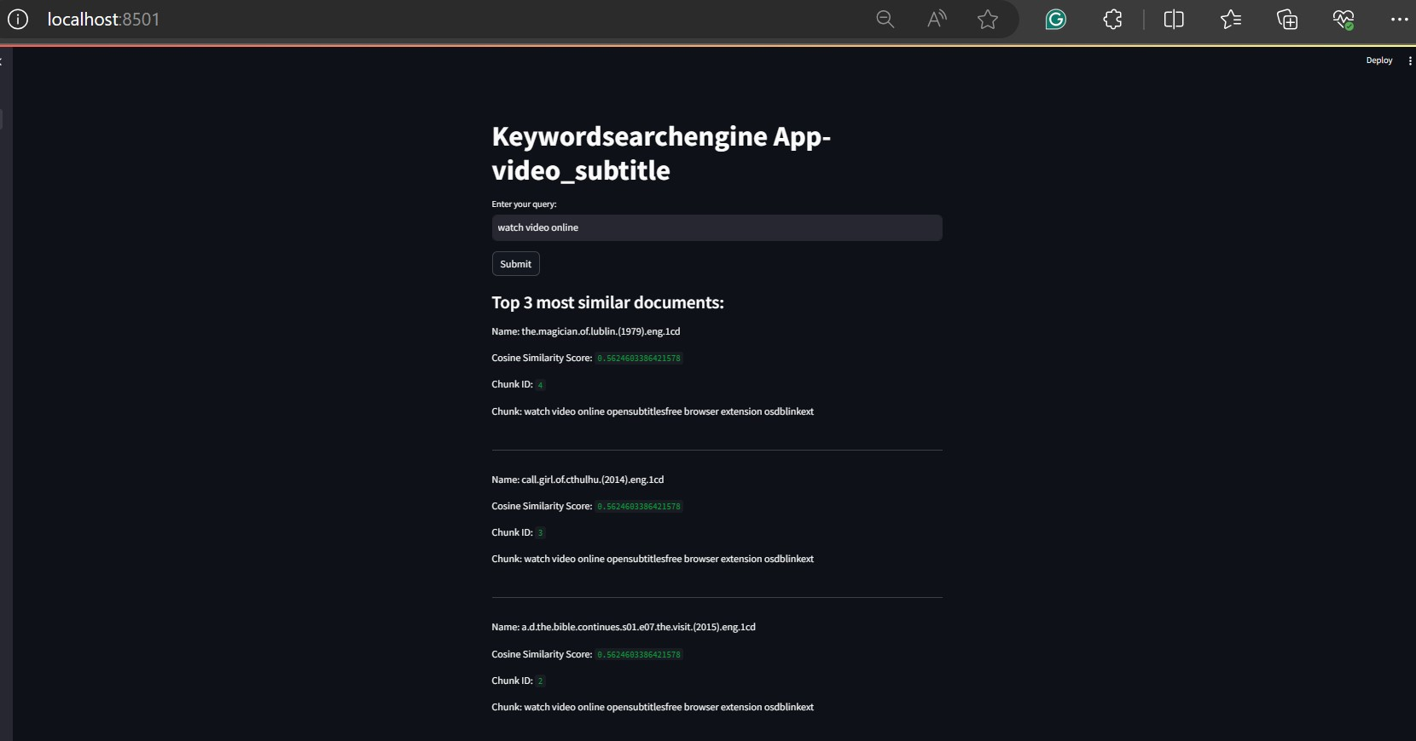
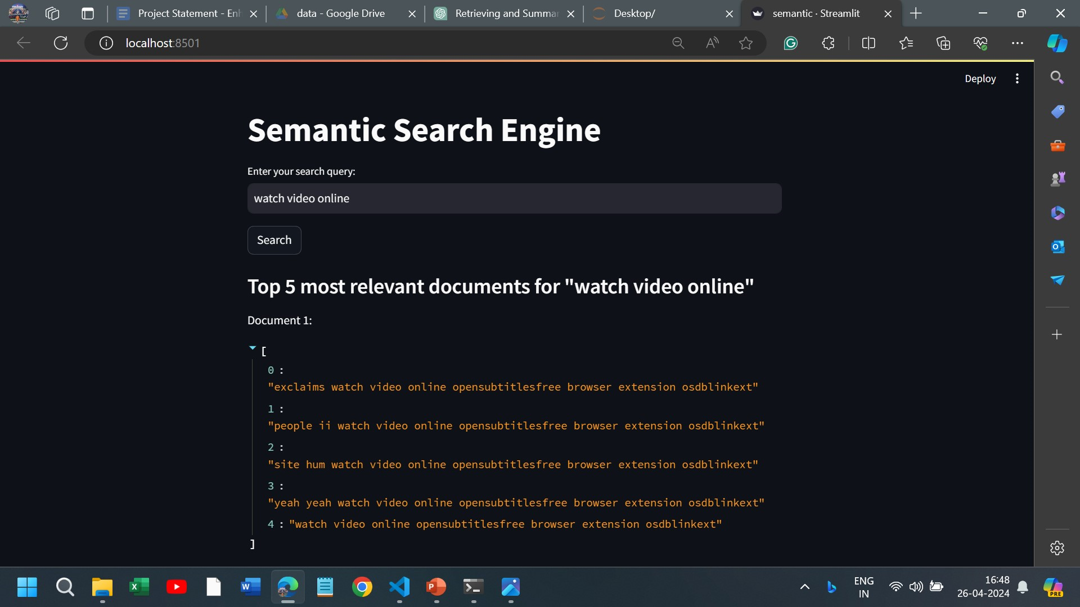
Comparison and Conclusion:
Keyword-based TF-IDF and Semantic BERT approaches offer distinct advantages: TF-IDF is effective for keyword-based retrieval and displays document names.
BERT provides semantic understanding but lacks document names, displaying content instead.
Depending on the use case, either method or a combination can be employed for efficient document retrieval based on user needs.

Slide 11

THANK YOU !

